Slide 1
MLB Analysis Data Project
Tim Hanlon
AI Bootcamp

Slide 2
Overview
This project analyzes MLB data using Python, combining hitter statistics and MLB ELO ratings. It calculates OPS, compares OPS between NL and AL, and the relationship between OPS and Runs.
Question: How much does OPS affect Runs?
Dependencies:
Python
Pandas
Matplotlib
Data Sources:
`Hitters.csv`: MLB hitter statistics (Kaggle)
`mlb_elo_latest.csv`: MLB ELO ratings (Kaggle)

Slide 3
Overview Pt. 2
Data loading (csv files) and combining the data (concat)
OPS calculation (OBP, SLG, and OPS)
OBP: walks + hits / at-bats
SLG: hits + 4 * homerun / at-bats
OPS: OBP + SLG / at-bats
Statistical analysis (average OPS by league, correlation between OPS and Runs)
Average OPS: NL 0.719, AL 0.740 (groupby and mean)
Correlation between OPS and Runs: 0.46 (corr)
This indicates that as OPS increases, then so do Runs
Data visualization (bar chart and scatter plot)

Slide 4
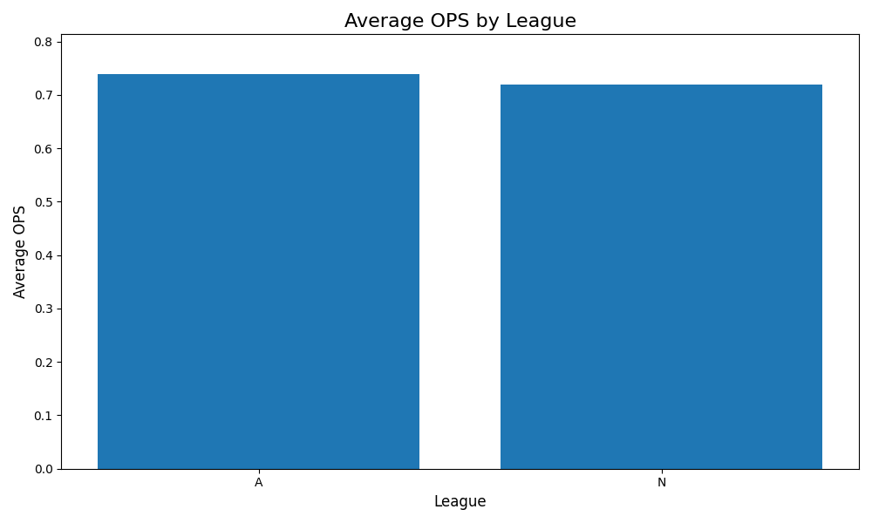
Bar Graph

Slide 5
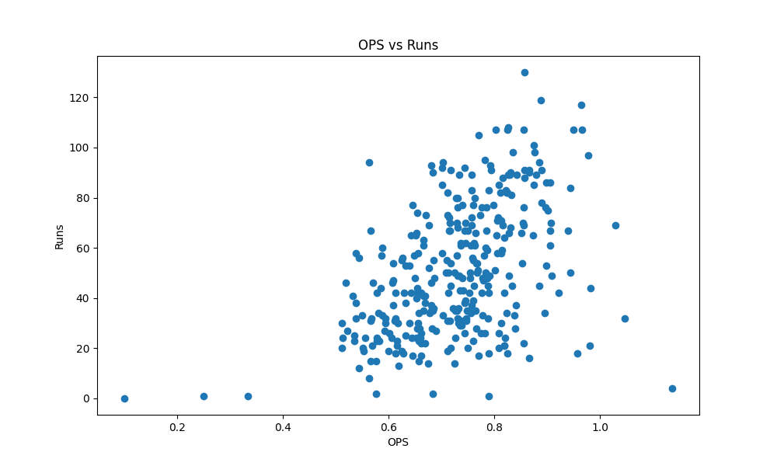
Scatter Plot

Slide 6
Conclusion
What I learned from this project is how to use Kaggle, adding CSV files, combining datasets using Pandas, calculating data and using matplotlib to create a bar graph and a scatter plot
The answer to my question, does OPS influence Runs? Yes, if you have a higher OPS you tend to have more runs

